Slide 1
IPv4 and Subnetting
IPv4 Review
How Packet travels on the internet?
What are the concerns and motivations behind the development of subnetting?
The eight attributes of network
Some types of subnetting questions
Practice.

Slide 2
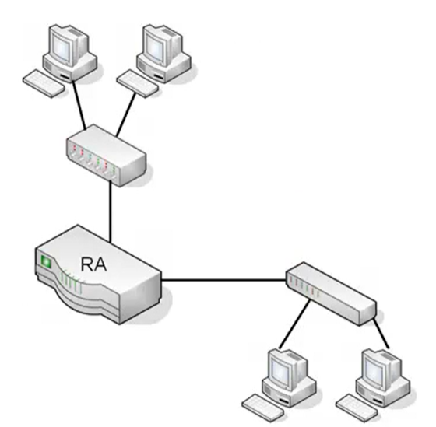
1. IPv4 Review

Slide 3
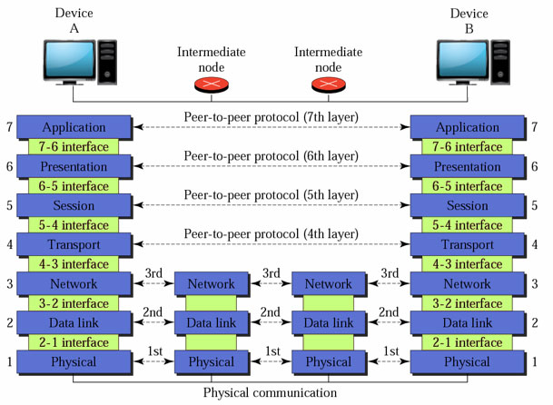
2. How packet traverses on the internet

Slide 4
3. What are the concerns and motivations of Subnetting
We don’t have enough uniquely identified IP addresses

Slide 5
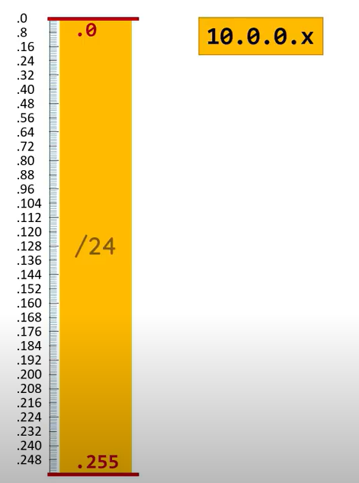
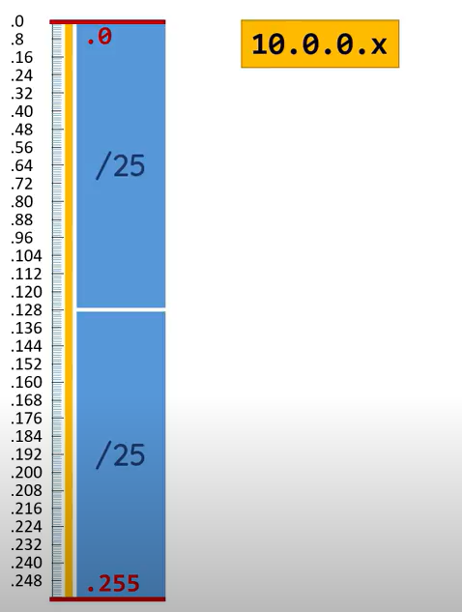
3. What is the concerns and motivation of subnetting (cont)
Taking a network and divides it into subnetwork

Slide 6
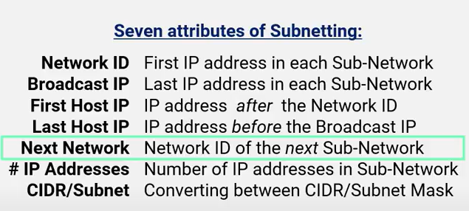
4. Eight attributes of Subnetting
The number of subnet that the current IP address is in

Slide 7






4. Practice examples

Slide 8
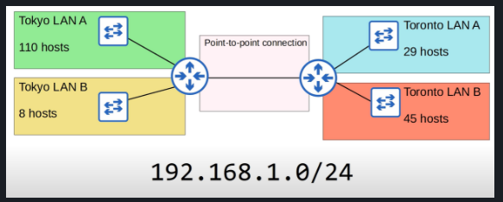
5. Some types of subnetting questions

Slide 9
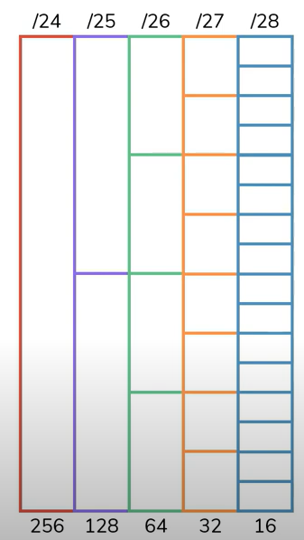
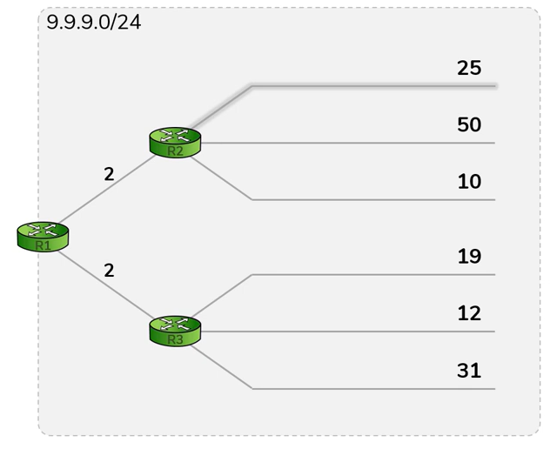
6. Practice

